Slide 1
Employee Data Analysis using Excel
STUDENT NAME: M. JASMINE MARY
REGISTER NO: 312213490, EDAFE98B499D749AFE4497DC02CA2B29
DEPARTMENT: BCOM COMMERCE
COLLEGE TAGORE COLLEGE OF ARTS AND SCIENCE

Slide 2
PROJECT TITLE
Employee Performance Analysis using Excel

Slide 3


AGENDA
Problem Statement
Project Overview
End Users
Our Solution and Proposition
Dataset Description
Modelling Approach
Results and Discussion
Conclusion
3/21/2024 Annual Review

Slide 4

PROBLEM STATEMENT
Performance analysis is an organization for which to do come and perform well
There should be average performing employees who perform very poorly donot know this
we are the ones who are suitable for their performance
We can come and do what we can do and motivate you in the same way
And it is an important factor for the growth of the Organization. So Analysis value mean
You can also focus on personal development with the particular employee over all growth of the organization Let's focus so this is what this Employee Performance Analysis.

Slide 5

PROJECT OVERVIEW
.
Data analysis means inspects, cleans, transforms, and models data to extract insights and support decision-making.
Data analysis typically utilizes tools such as Python, R, SQL for programming, and Power BI, Tableau, and Excel for visualization and data management.
Employee performance metrics are a set of measurable values that gauge your team members' individual productivity, efficiency, and overall performance.

Slide 6

WHO ARE THE END USERS?
Employee
Employers
Oraganisation
Different industries
IT Sector

Slide 7

OUR SOLUTION AND ITS VALUE PROPOSITION
Filtering _ The FILTER function allows you to filter a range of data based on criteria you define missing values
Conditional formatting _ blank values
Pivot Table _ PivotTable to summarize, analyze, explore, and present summary data.
Chart _ Select Insert > Recommended Charts

Slide 8
Dataset Description
Employee data set- Kaggle
26 features
Feature - 9 features
Emp id
Gender-male, female
Performance
Business Unit
Name
Rating_Numerical

Slide 9

THE "WOW" IN OUR SOLUTION
3/21/2024 Annual Review
9

Slide 10
MODELLING
Data collection
Data Cleaning
Techniques
Results
Pivot Table
Chart & Graphs
10

Slide 11
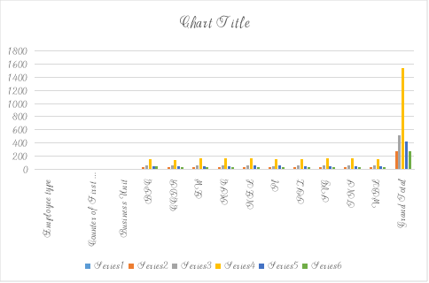
RESULTS
11

Slide 12
conclusion

